Slide 1
Predictive Maintenance For Airlines
Using IBM Watson Studio
BY-
Mula Anvesh Reddy
GITAM University
121810315030@gitam.in

Slide 2
Introduction
The Airport's capacity has been growing year after year, and the conventional saying of allocating airport resources has been unable to keep up with the changing needs of the airport.
One of the most efficient ways to improve customer service levels and operational efficiency within the terminal is to dynamically allocate and schedule passenger service resources.
While the relatively accurate passenger traffic forecasting is the prerequisite for dynamic allocation and scheduling.

Slide 3
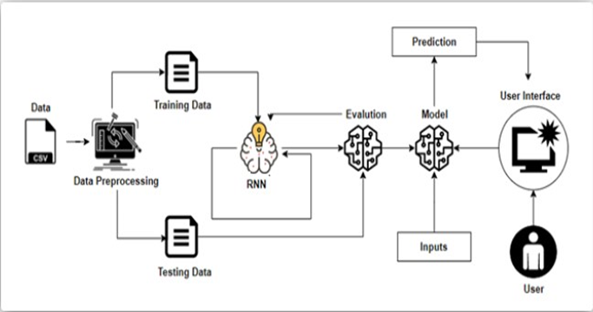
Block Diagram

Slide 4
Project Flow
Data Collection.
Collect the dataset or create the dataset.
Data Preprocessing.
Import the libraries
Reading the dataset
Handling missing values
Data Visualization
Split the data into train and test
Normalize the data
Reshape the train and test data
Model Building
Import the model building Libraries
Initializing the model
Adding LSTM Layer
Adding Output Layer
Configure the Learning Process
Training and testing the model
Optimize the Model
Save the Model
Application Building
Build HTML page.
Build Python code.

Slide 5
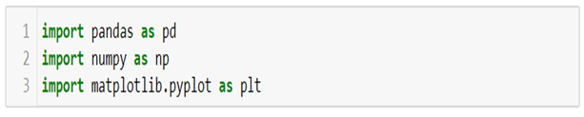
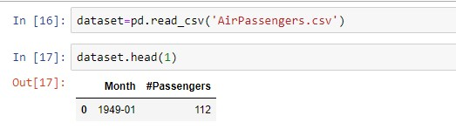
Importing Libraries
Reading the dataset and viewing the data

Slide 6
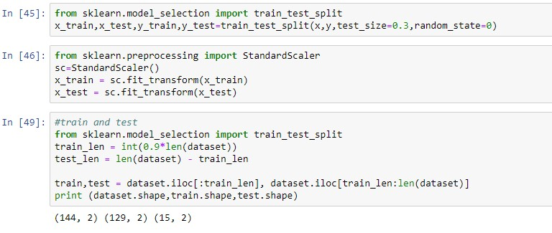
Split the data into train and test

Slide 7
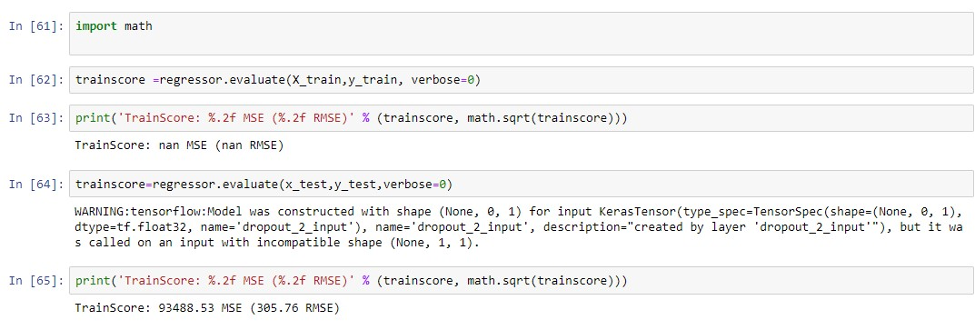
Finding the Accuracy
Save the file with .h5 extension,to access the file in flask

Slide 8
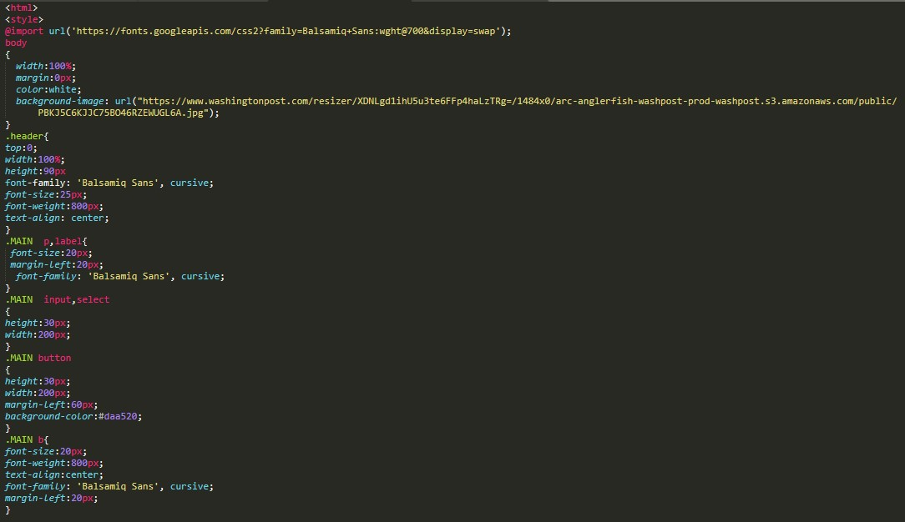
UI

Slide 9
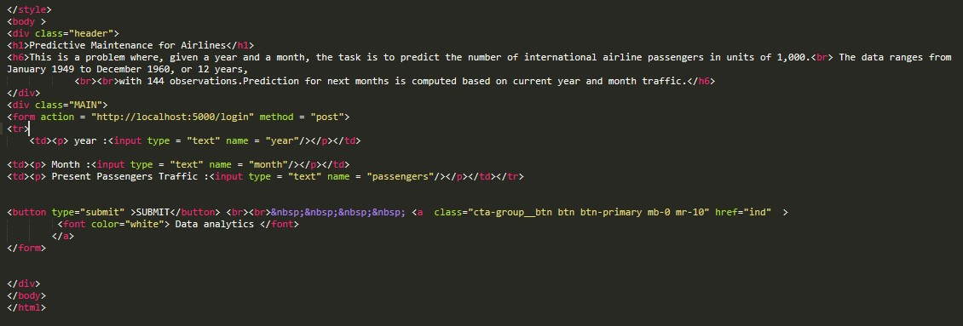
Index.html

Slide 10
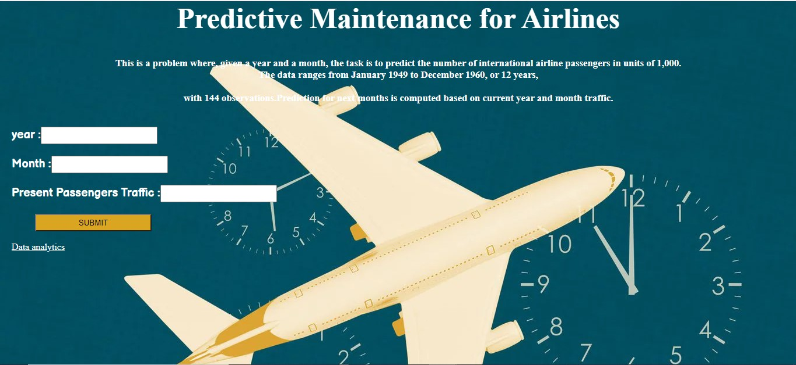
Index Page

Slide 11
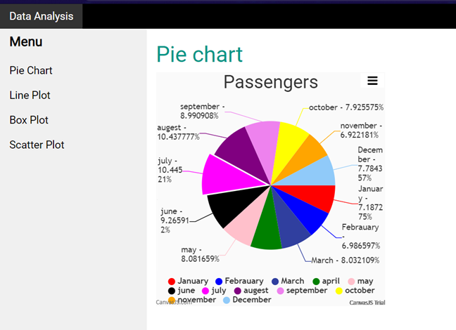
Pie Chart

Slide 12
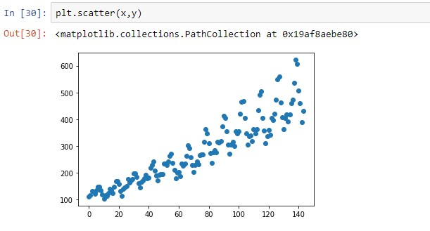
Scatter Plot

Slide 13
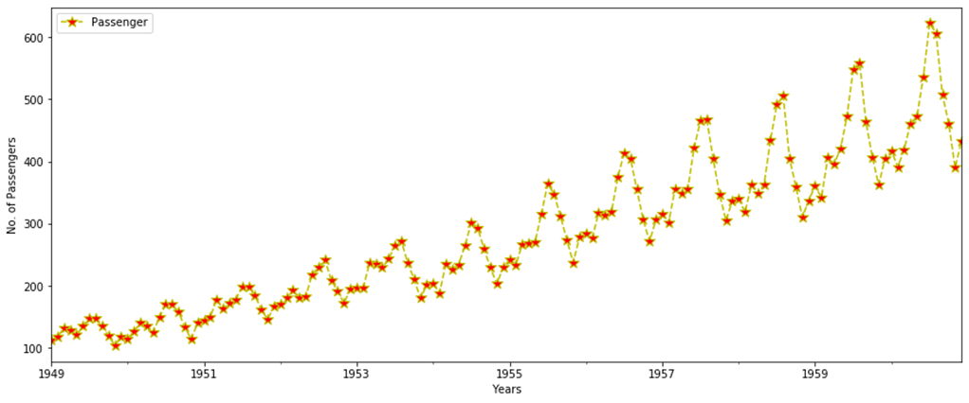
Line Plot

Slide 14
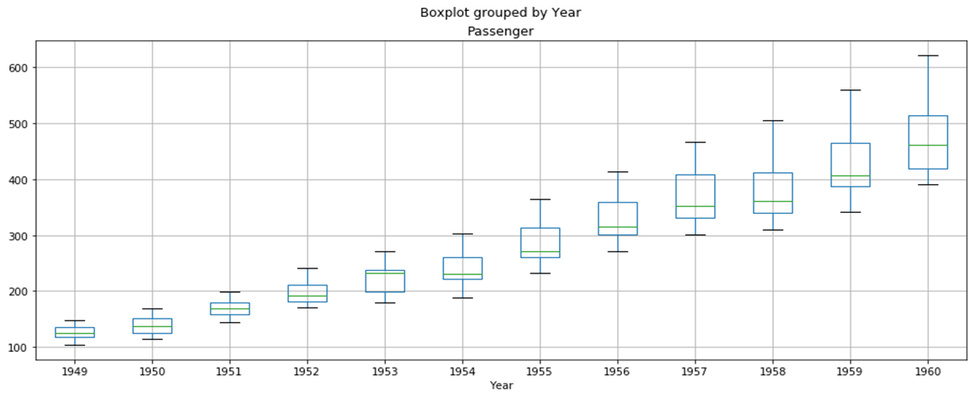
Box Plot

Slide 15


